Slide 1



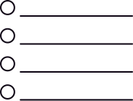
Document Extraction and Validation on Myron AI
Myron AI workflow 1 -
Pdf Upload
Activates the uploaded document for downstream analysis.
Uploads and Activates
API Call
Myron AI workflow 2 - PDFRemittance
Run Analysis
Analysis Report generated
A RAG that Validates uploaded Remittance PDF against runtime provided rules.
Returns one strict JSON response with passed/failed/review rules.
User
Frontend
Rules
Uploads PDF for validation against rules.
Set of rules pulled from the database having all the rules.
No changes made to the rules stored in the database

